Slide 1
Lecture #4: Multiple Linear Regression

Slide 2
ANNOUNCEMENTS
HW2 is available, due Tues, July 7 at 11:59pm
Lab2 is tomorrow 12-2pm, not Friday due to the holiday.
Lec3 Quiz (the feedback survey) will be left available until tomorrow morning. Please fill out for ‘free’ full credit quiz. (Lec4 Quiz will be released after class, available for 36+ hours).

Slide 3
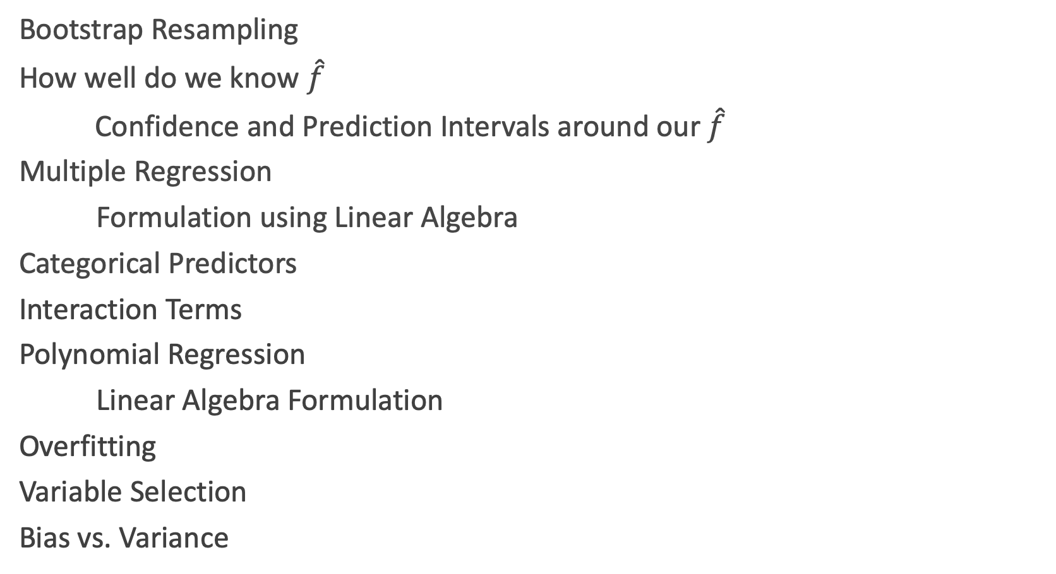
Lecture Outline
Bootstrap Resampling
How well do we know $\hat{f}$
Confidence and Prediction Intervals around our $\hat{f}$
Multiple Regression
Formulation using Linear Algebra
Categorical Predictors
Interaction Terms
Polynomial Regression
Linear Algebra Formulation
Overfitting
Variable Selection
Bias vs. Variance

Slide 4
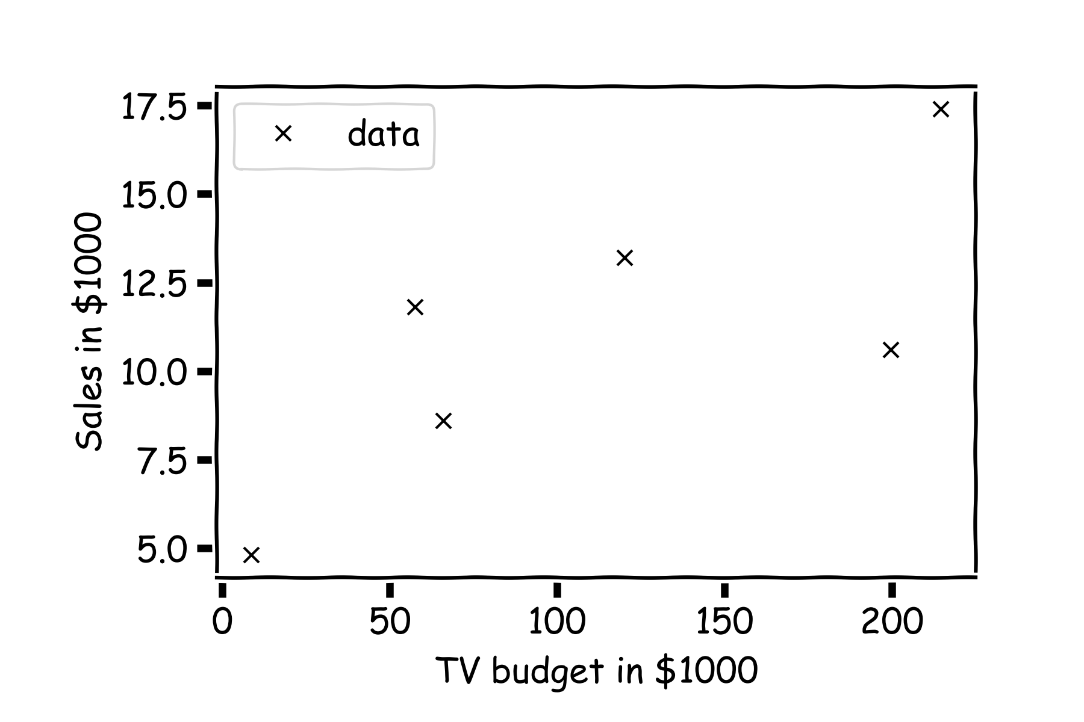
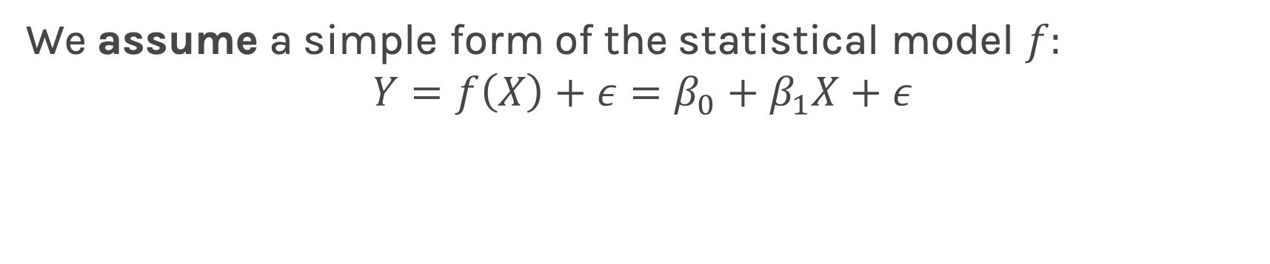
Summary from last lecture
We assume a simple form of the statistical model $f:$
$$Y=f\left(X\right)+ε=β_{0}+β_{1}X+ε$$

Slide 5
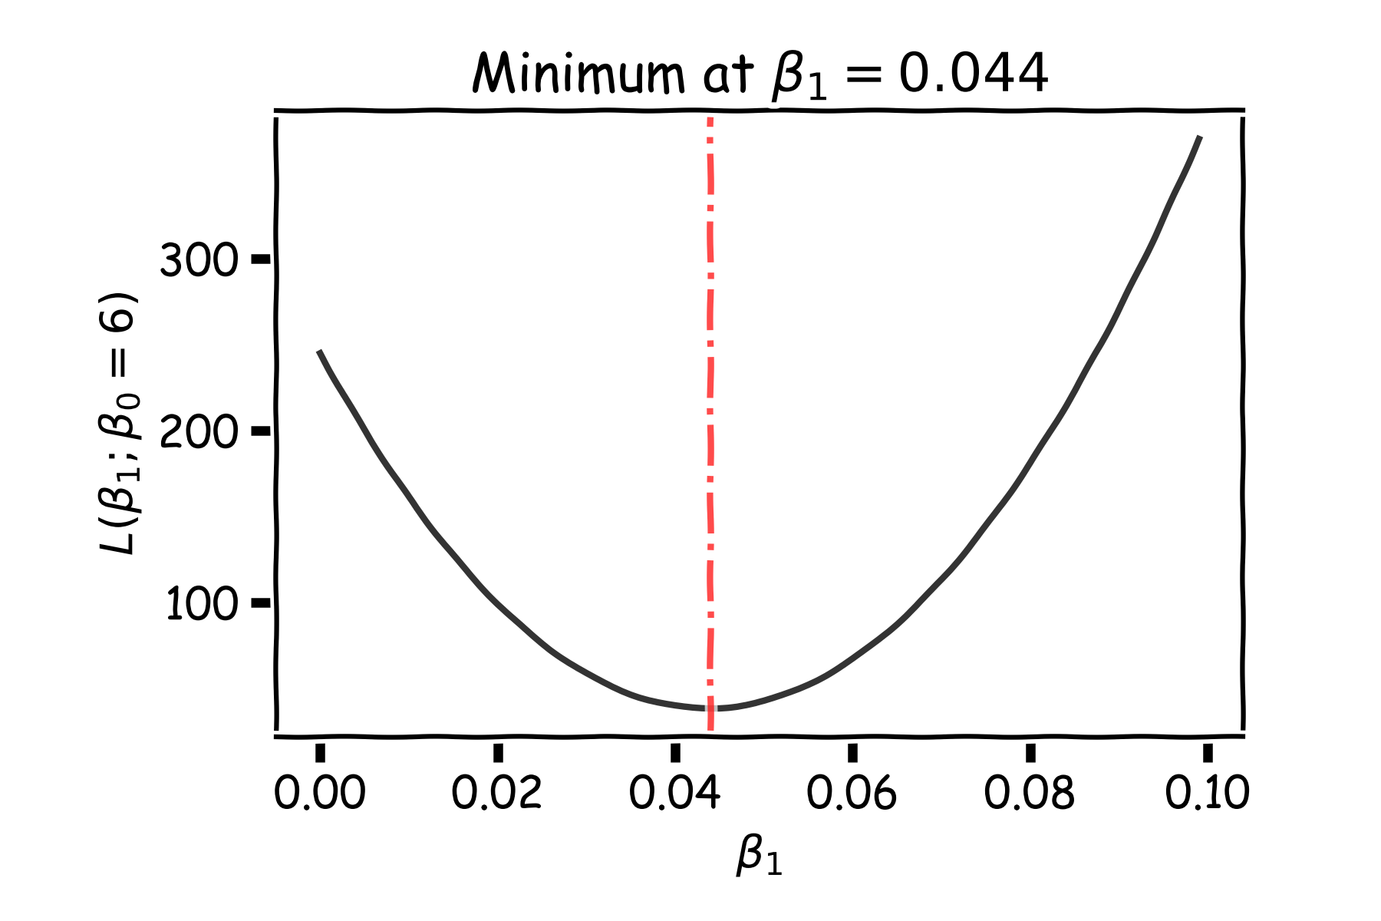
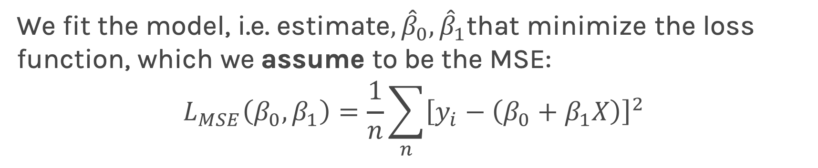
Summary from last lecture
We fit the model, i.e. estimate$, {\hat{β}}_{0},{\hat{β}}_{1}$that minimize the loss function, which we assume to be the MSE:
$$L_{MSE}\left(β_{0}, β_{1}\right)=\frac{1}{n}\sum_{n}{{\left[y_{i}−\left(β_{0}+β_{1}X\right)\right]}^{2}}$$

Slide 6
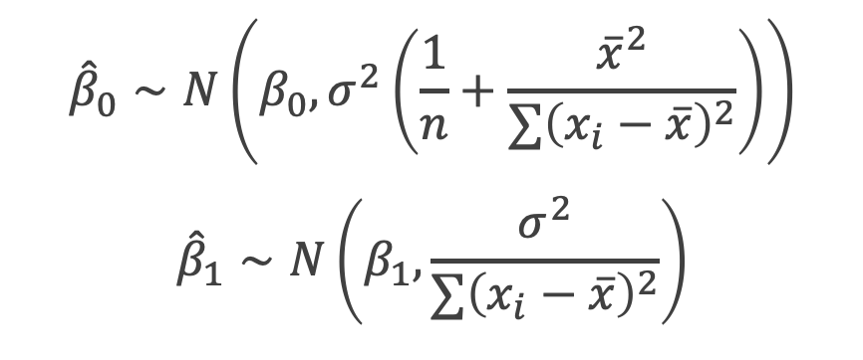
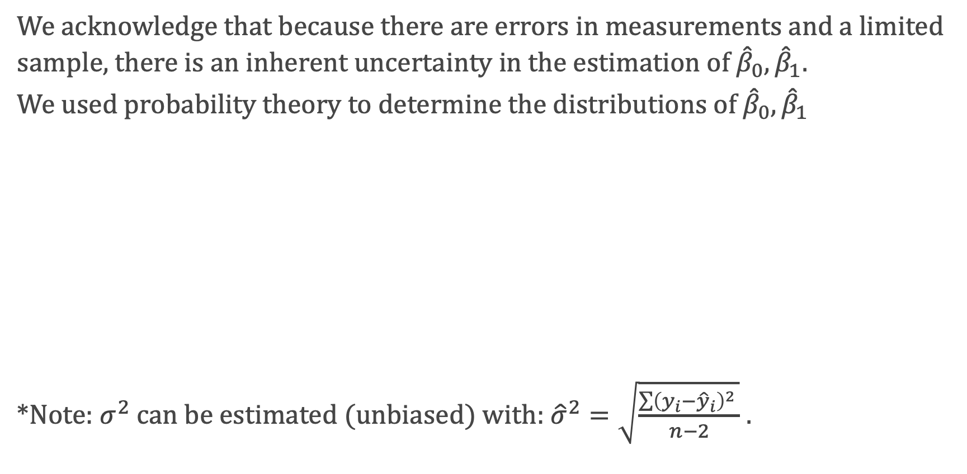
Summary from last lecture
We acknowledge that because there are errors in measurements and a limited sample, there is an inherent uncertainty in the estimation of ${\hat{β}}_{0},{\hat{β}}_{1}.$
We used probability theory to determine the distributions of ${\hat{β}}_{0},{\hat{β}}_{1}$
*Note: $σ^{2}$ can be estimated (unbiased) with: ${\hat{σ}}^{2}=\sqrt{\frac{\sum{{\left(y_{i}−{\hat{y}}_{i}\right)}^{2}} }{n−2}}$ .
$${\hat{β}}_{0}∼N\left(β_{0},σ^{2}\left(\frac{1}{n}+\frac{{\overline{x}}^{2}}{∑{\left(x_{i}−\overline{x}\right)}^{2}}\right)\right)$$
$${\hat{β}}_{1}∼N\left(β_{1},\frac{σ^{2}}{∑{\left(x_{i}−\overline{x}\right)}^{2}}\right)$$

Slide 7
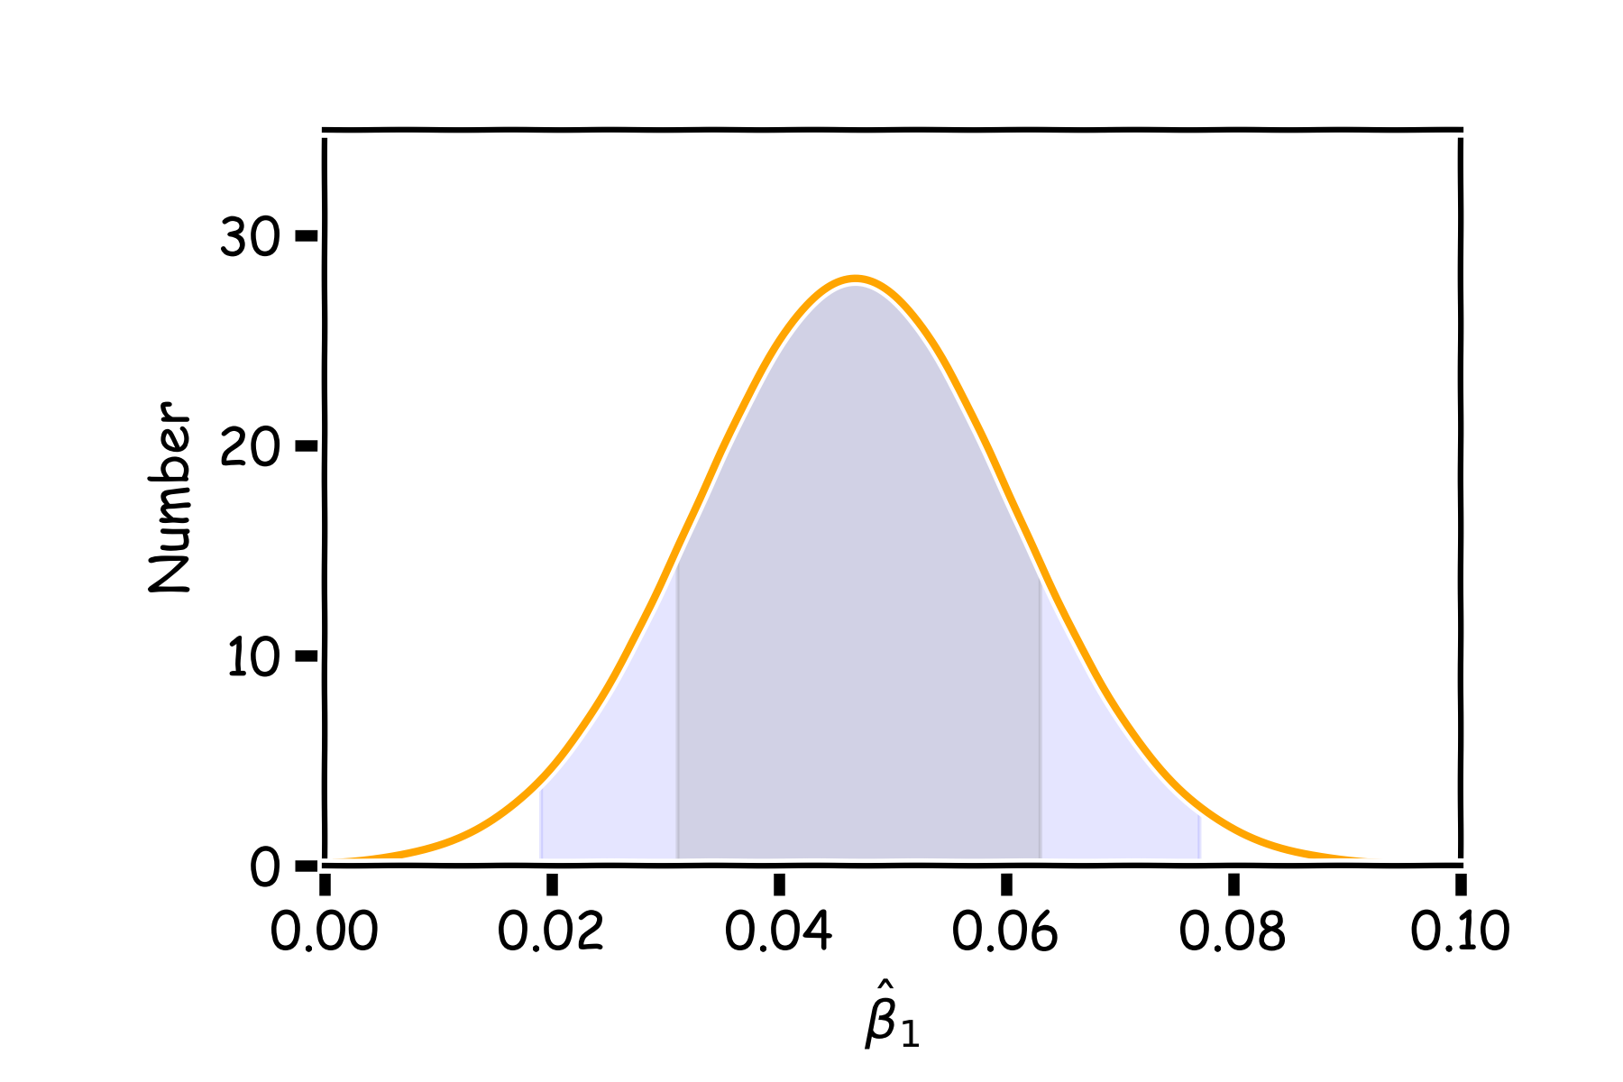
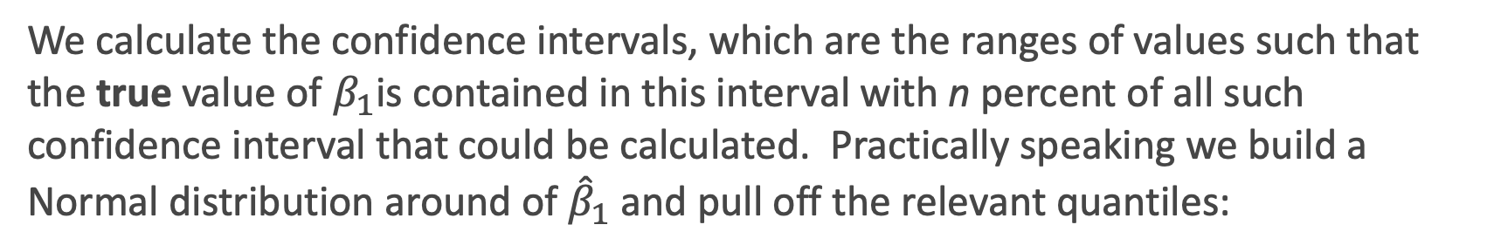
Summary from last lecture
We calculate the confidence intervals, which are the ranges of values such that the true value of $β_{1}$is contained in this interval with n percent of all such confidence interval that could be calculated. Practically speaking we build a Normal distribution around of ${\hat{β}}_{1}$and pull off the relevant quantiles:
95%
68%

Slide 8
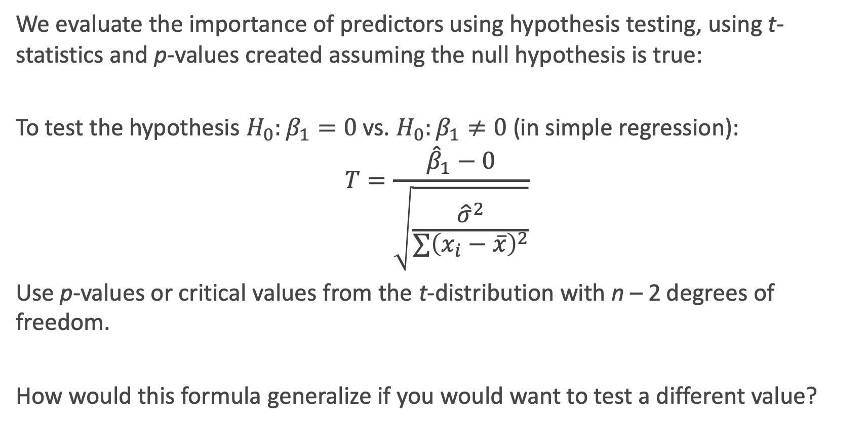
Summary from last lecture
We evaluate the importance of predictors using hypothesis testing, using t-statistics and p-values created assuming the null hypothesis is true:
To test the hypothesis $H_{0}:β_{1}=0$vs. $H_{0}:β_{1}≠0$(in simple regression):
$$T=\frac{{\hat{β}}_{1}−0}{\sqrt{\frac{{\hat{σ}}^{2}}{∑{\left(x_{i}−\overline{x}\right)}^{2}}}}$$
Use p-values or critical values from the t-distribution with n – 2 degrees of freedom.
How would this formula generalize if you would want to test a different value?

Slide 9
Alternative to Probability Theory: the Bootstrap
In the lack of active imagination, parallel universes and the likes, or trusting the probabilistic models, we need an alternative way of producing fake data set that resemble the parallel universes.
.
Bootstrapping is the practice of sampling from the observed data (X,Y) in estimating statistical properties (sometimes called resampling).

Slide 10
Bootstrap
Imagine we have 5 billiard balls in a bucket.

Slide 11
Bootstrap
We first pick randomly a ball and replicate it. This is called sampling with replacement.
We move the replicated ball to another bucket.

Slide 12
Bootstrap

Slide 13
Bootstrap
We then randomly pick another ball and again we replicate it.
As before, we move the replicated ball to the other bucket.

Slide 14
Bootstrap

Slide 15
Bootstrap
We repeat this process.
Notes:
Fix this with true replacement

Slide 16
Bootstrap
Again

Slide 17
Bootstrap
And again

Slide 18
Bootstrap
Until the “other” bucket has the same number of balls as the original one.
This new bucket represents a new parallel universe

Slide 19
Bootstrap
We repeat the same process and acquire another sample.

Slide 20
Bootstrap
We repeat the same process and acquire another sample.
These new buckets represents the parallel universes

Slide 21
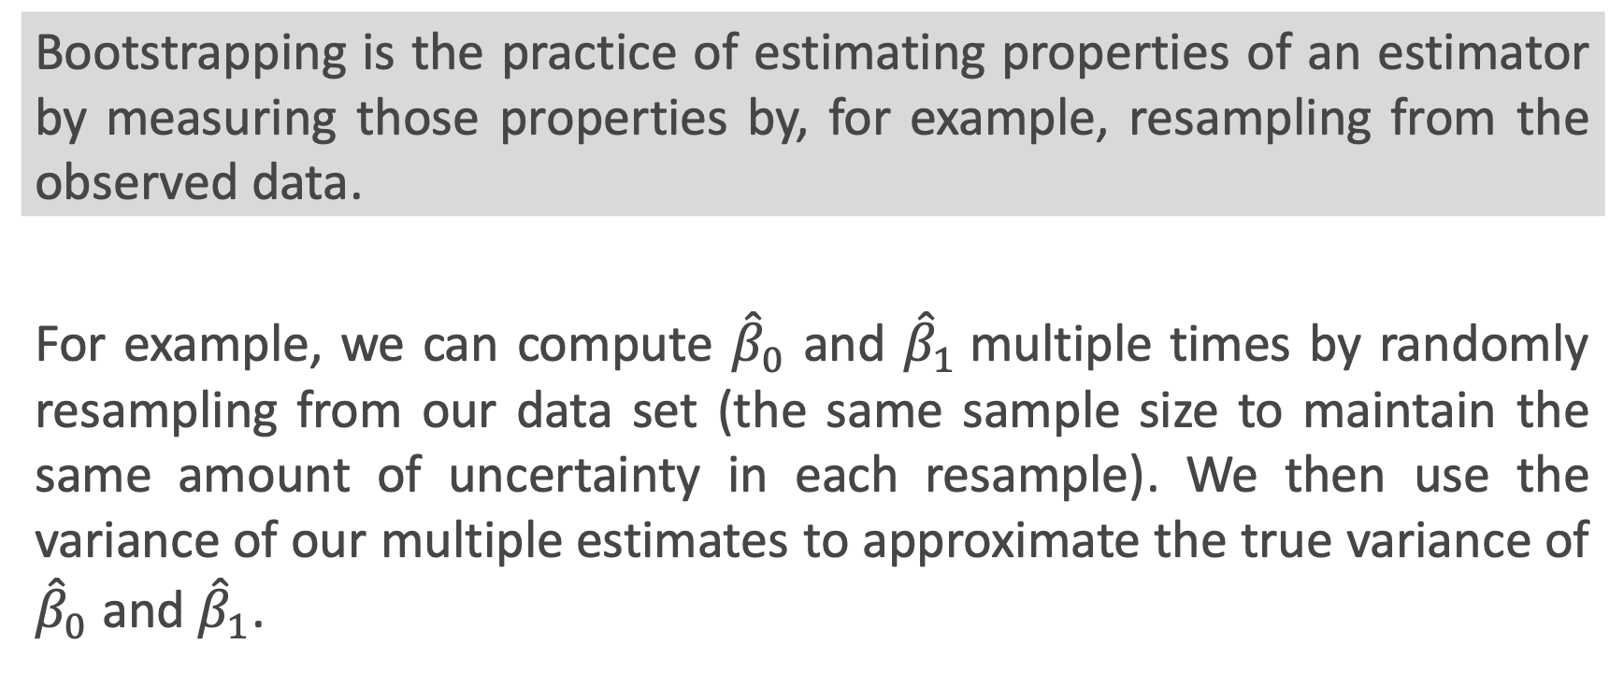
Bootstrapping for Estimating Sampling Error
Definition
Bootstrapping is the practice of estimating properties of an estimator by measuring those properties by, for example, resampling from the observed data.
For example, we can compute ${\hat{β}}_{0}$ and ${\hat{β}}_{1}$multiple times by randomly resampling from our data set (the same sample size to maintain the same amount of uncertainty in each resample). We then use the variance of our multiple estimates to approximate the true variance of ${\hat{β}}_{0}$ and ${\hat{β}}_{1}$.

Slide 22
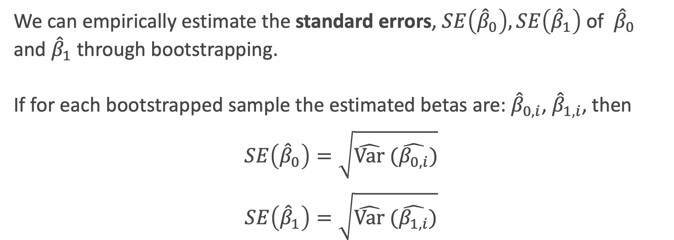
Confidence intervals for the predictors estimates: Standard Errors
We can empirically estimate the standard errors, $SE\left({\hat{β}}_{0}\right),SE\left({\hat{β}}_{1}\right)$ of ${\hat{β}}_{0}$ and ${\hat{β}}_{1}$through bootstrapping.
If for each bootstrapped sample the estimated betas are: ${\hat{β}}_{0,i}$, ${\hat{β}}_{1,i}$, then
$$SE\left({\hat{β}}_{0}\right)=\sqrt{\hat{Var} (\hat{β_{0,i}})}$$
$$SE\left({\hat{β}}_{1}\right)=\sqrt{\hat{Var} (\hat{β_{1,i}})}$$
Notes:
If data set is small this approximation does not work

Slide 23
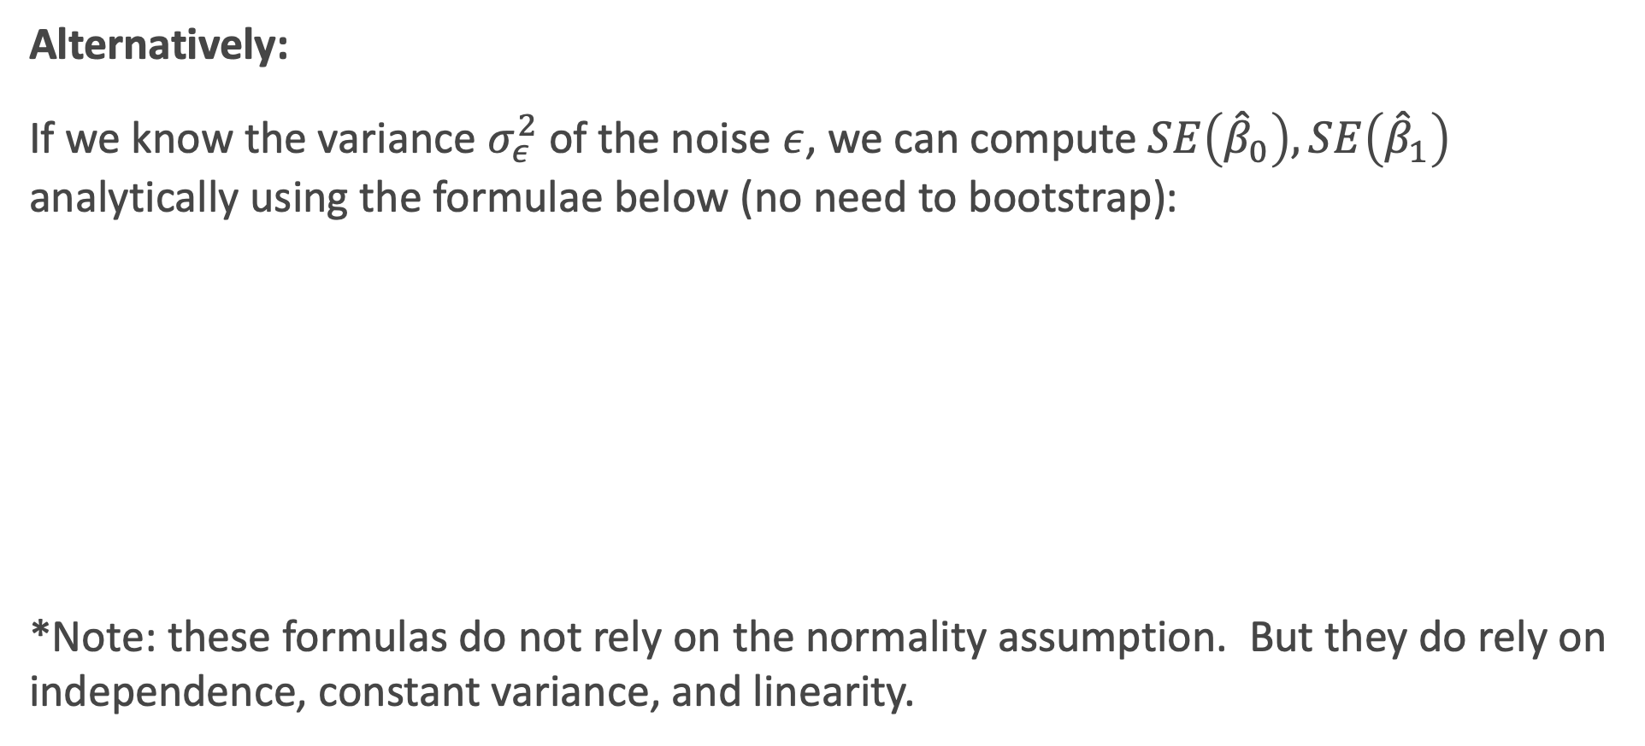
Confidence intervals for the predictors estimates: Standard Errors
Alternatively:
If we know the variance $σ_{ε}^{2}$ of the noise $ε$, we can compute $SE\left({\hat{β}}_{0}\right),SE\left({\hat{β}}_{1}\right)$ analytically using the formulae below (no need to bootstrap):
*Note: these formulas do not rely on the normality assumption. But they do rely on independence, constant variance, and linearity.
Notes:
If data set is small this approximation does not work

Slide 24
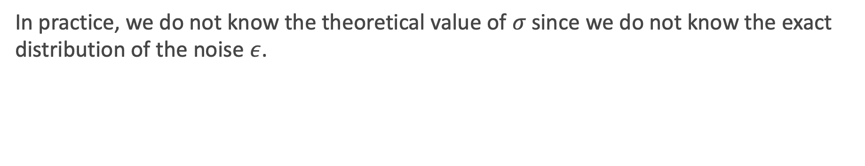
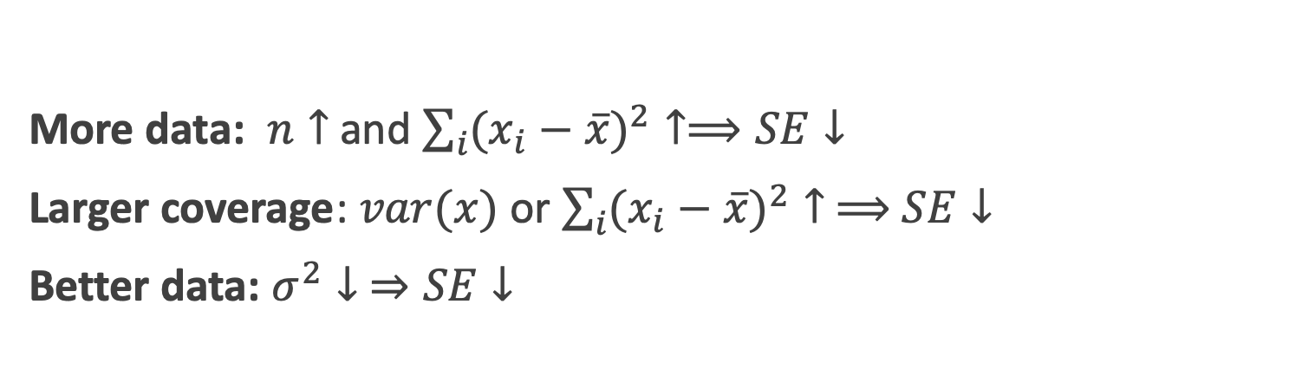
Standard Errors
More data: $n↑$ and $\sum_{i}{({x_{i}−\overline{x})}^{2}}↑⟹SE↓$
Larger coverage: $var(x)$ or $\sum_{i}{({x_{i}−\overline{x})}^{2}}↑ ⟹$ $SE↓$
Better data: $σ^{2}↓ ⇒SE↓$
In practice, we do not know the theoretical value of $σ$ since we do not know the exact distribution of the noise $ε$.
Notes:
If data set is small this approximation does not work

Slide 25
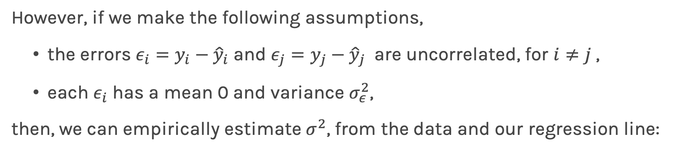
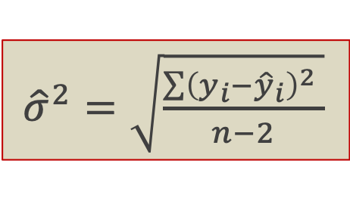

Standard Errors
However, if we make the following assumptions,
the errors $ε_{i}=y_{i}−{\hat{y}}_{i}$and $ε_{j}=y_{j}−{\hat{y}}_{j}$ are uncorrelated, for $i≠j$ ,
each $ε_{i}$ has a mean 0 and variance $σ_{ε}^{2}$,
then, we can empirically estimate $σ^{2}$, from the data and our regression line:
${\hat{σ}}^{2}=\sqrt{\frac{\sum{{\left(y_{i}−{\hat{y}}_{i}\right)}^{2}} }{n−2}}$
Remember:
$$y_{i}=f\left(x_{i}\right)+ε_{i}⟹ε_{i}=y_{i}−f(x_{i})$$

Slide 26
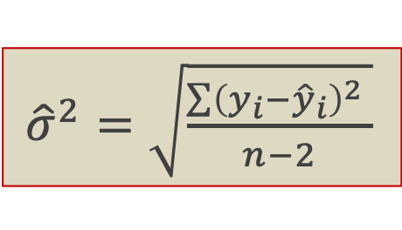
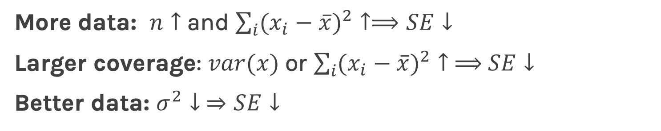
Standard Errors
More data: $n↑$ and $\sum_{i}{({x_{i}−\overline{x})}^{2}}↑⟹SE↓$
Larger coverage: $var(x)$ or $\sum_{i}{({x_{i}−\overline{x})}^{2}}↑ ⟹$ $SE↓$
Better data: $σ^{2}↓ ⇒SE↓$
${\hat{σ}}^{2}=\sqrt{\frac{\sum{{\left(y_{i}−{\hat{y}}_{i}\right)}^{2}} }{n−2}}$
Better model: $(\hat{f}−y_{i}) ↓$ $⟹σ↓ ⟹SE↓$
Question: What happens to the $\hat{β_{0}}$, $\hat{β_{1}}$ under these scenarios?

Slide 27
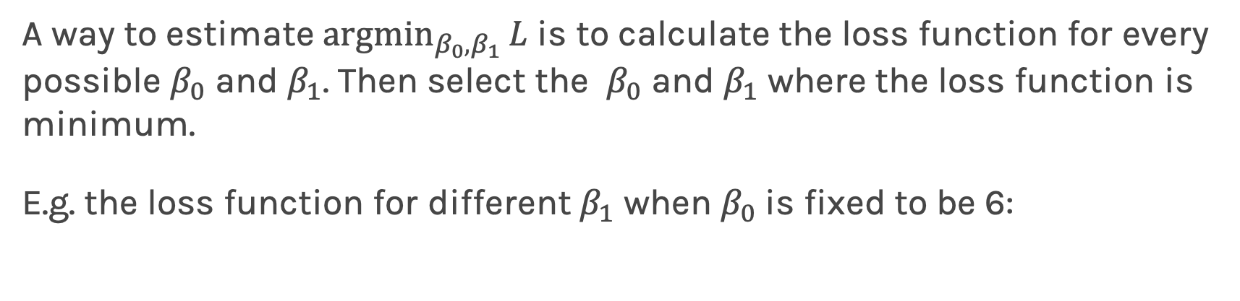
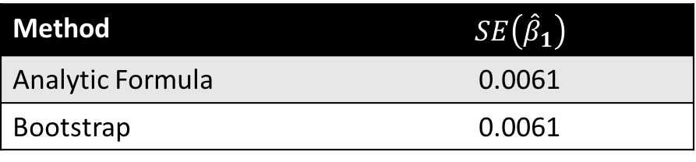
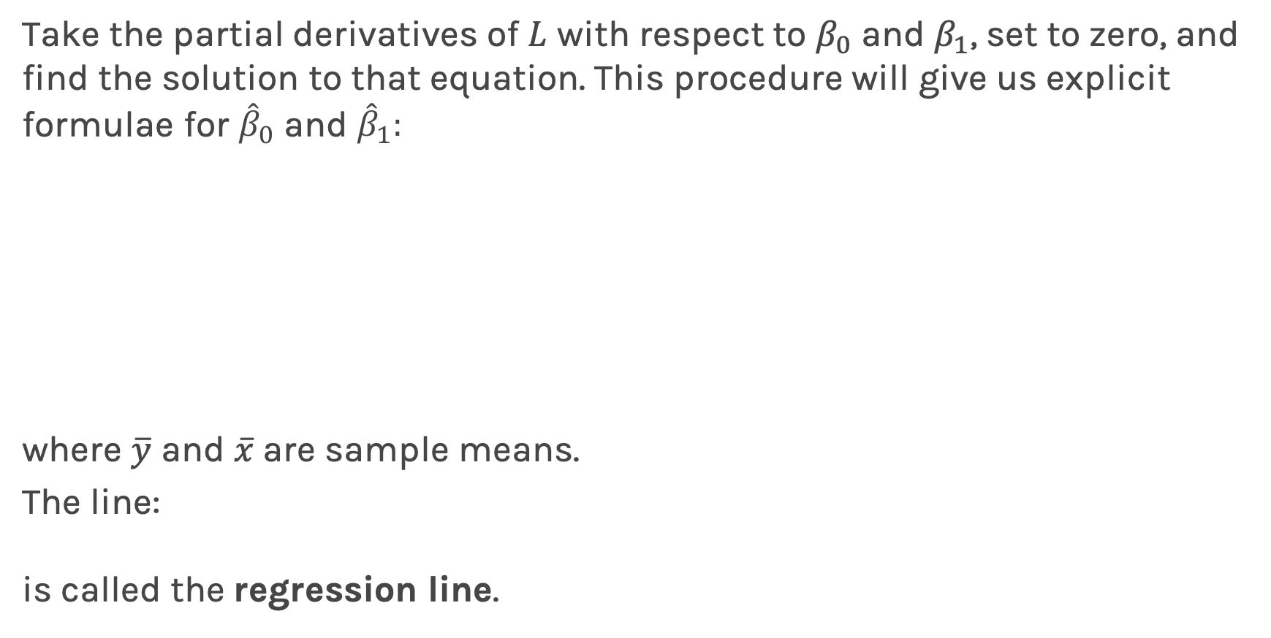
Standard Errors
The following results are for the coefficients for TV advertising:
Method | $$SE\left({\hat{β}}_{1}\right)$$
Analytic Formula | 0.0061
Bootstrap | 0.0061
The coefficients for TV advertising but restricting the coverage of x are:
The coefficients for TV advertising but with added extra noise:
Method | $$SE\left({\hat{β}}_{1}\right)$$
Analytic Formula | 0.0068
Bootstrap | 0.0068
Does this make sense?
Method | $$SE\left({\hat{β}}_{1}\right)$$
Analytic Formula | 0.0028
Bootstrap | 0.0023

Slide 28
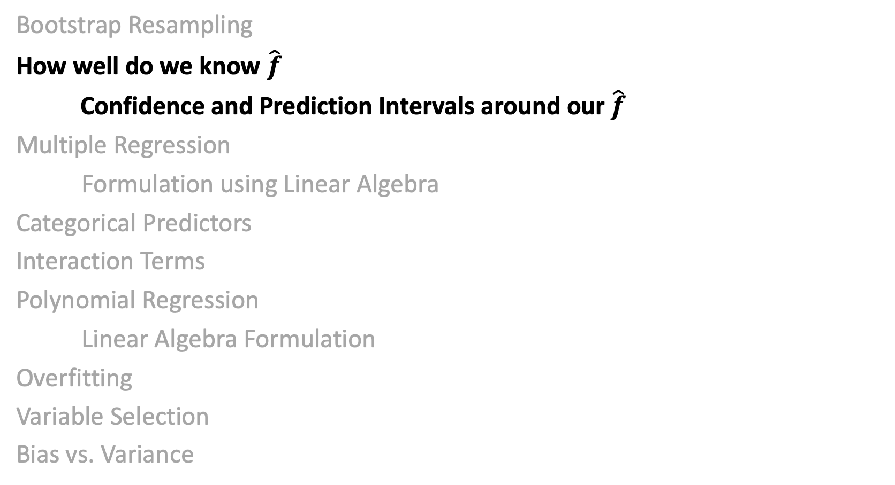
Lecture Outline
Bootstrap Resampling
How well do we know $\hat{f}$
Confidence and Prediction Intervals around our $\hat{f}$
Multiple Regression
Formulation using Linear Algebra
Categorical Predictors
Interaction Terms
Polynomial Regression
Linear Algebra Formulation
Overfitting
Variable Selection
Bias vs. Variance

Slide 29
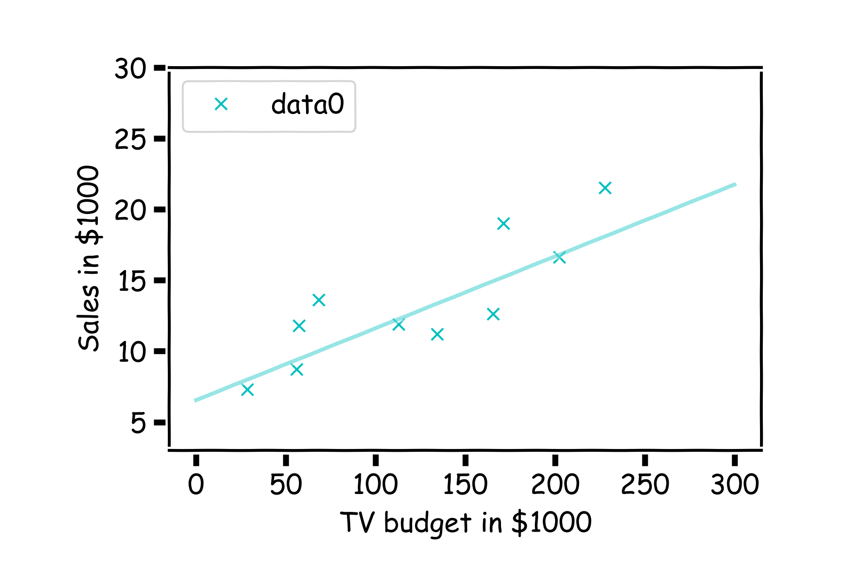
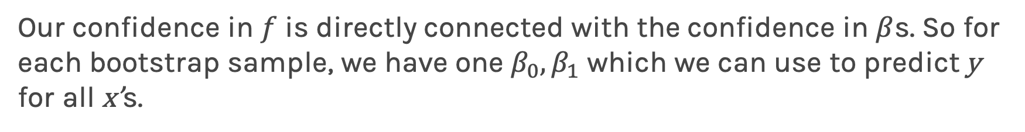
How well do we know $\hat{f}$?
Our confidence in $f$ is directly connected with the confidence in $β$s. So for each bootstrap sample, we have one $β_{0},β_{1}$ which we can use to predict y for all x’s.

Slide 30
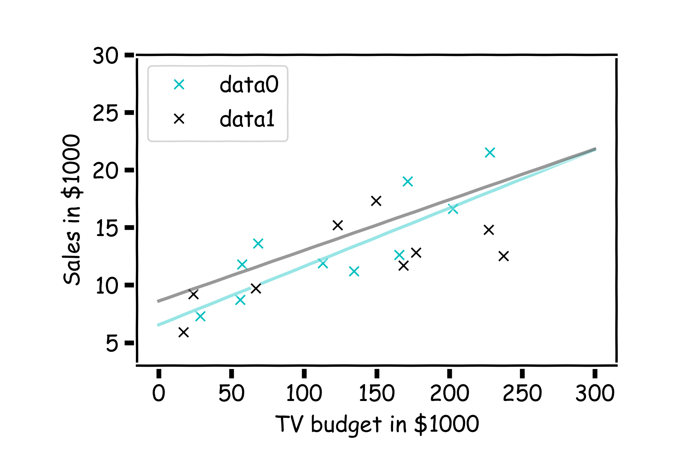
How well do we know $\hat{f}$?
Here we show two difference set of models given the fitted coefficients.

Slide 31
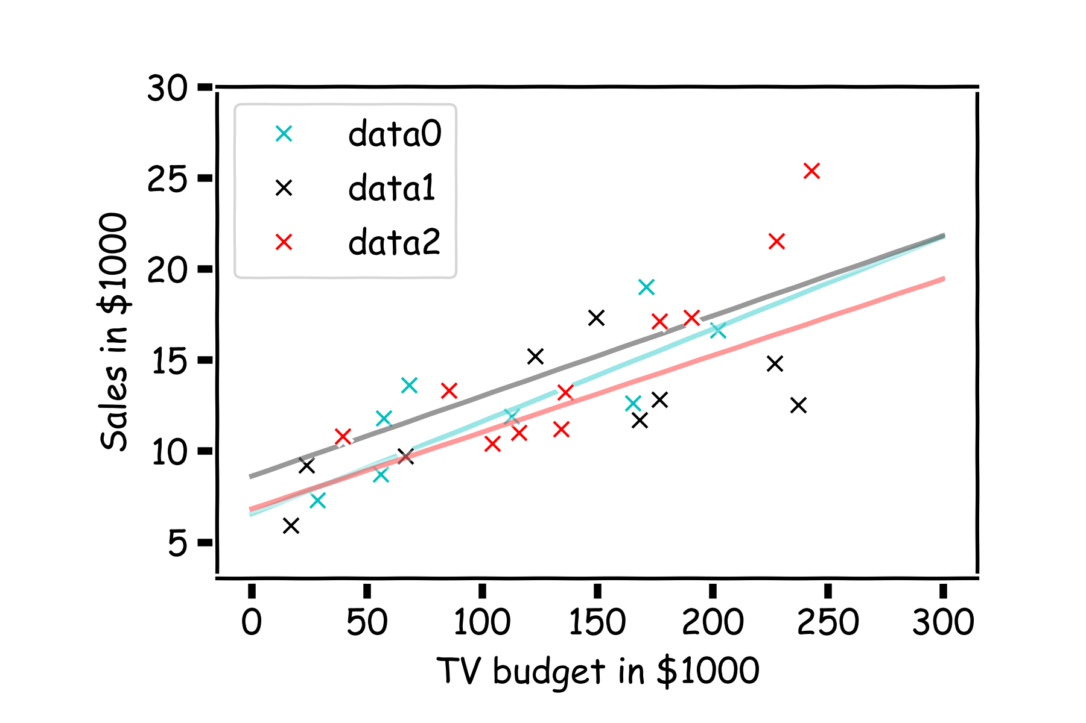
How well do we know $\hat{f}$?
There is one such regression line for every bootstrapped sample.

Slide 32
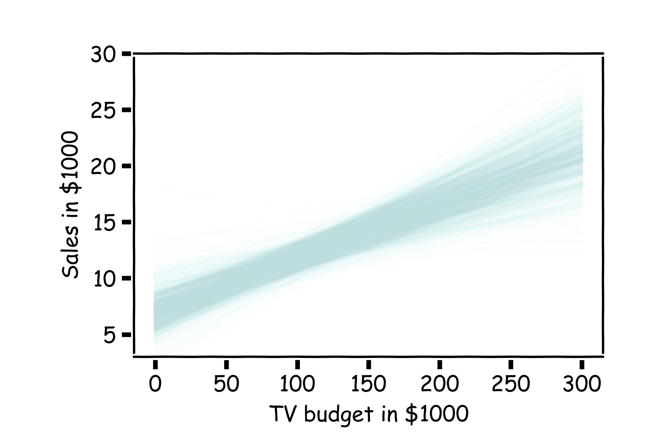
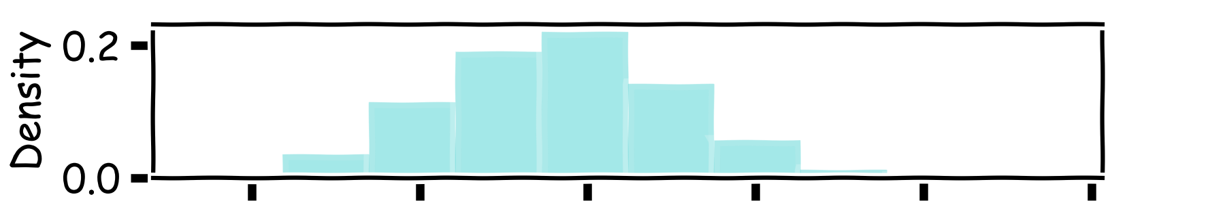
How well do we know $\hat{f}$?
Below we show all regression lines for a thousand of such bootstrapped samples.
For a given $x$, we examine the distribution of $\hat{f}$, and determine the mean and standard deviation.

Slide 33
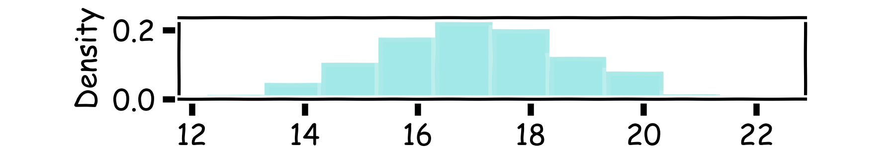
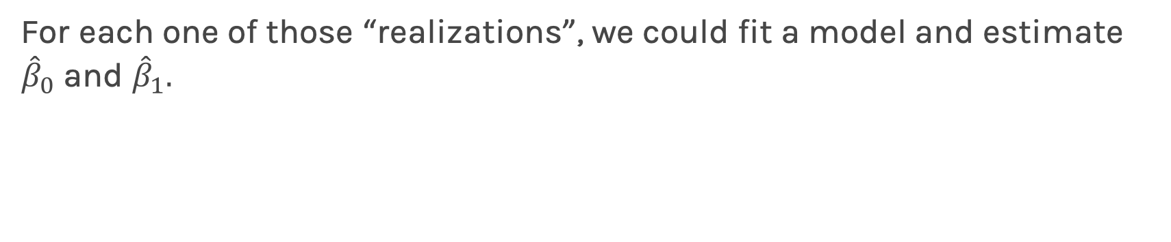
How well do we know $\hat{f}$?
Below we show all regression lines for a thousand of such sub-samples.
For a given $x$, we examine the distribution of $\hat{f}$, and determine the mean and standard deviation.

Slide 34
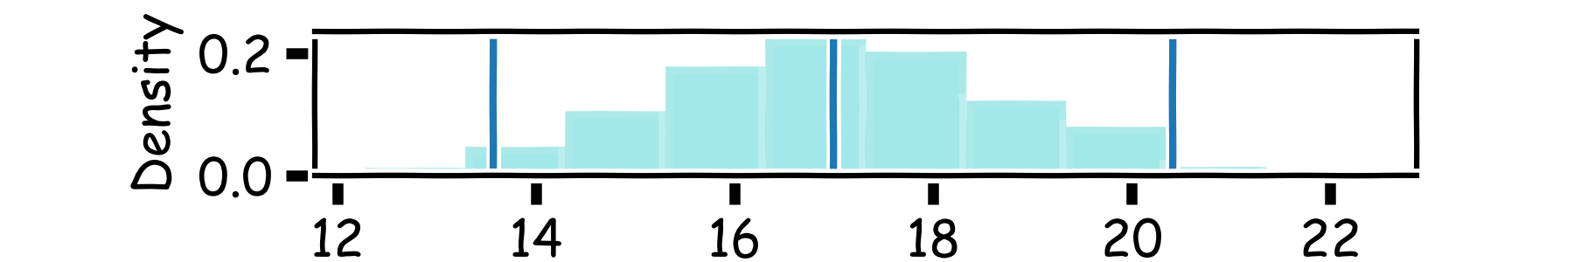
How well do we know $\hat{f}$?
Below we show all regression lines for a thousand of such sub-samples.
For a given $x$, we examine the distribution of $\hat{f}$, and determine the mean and standard deviation.

Slide 35
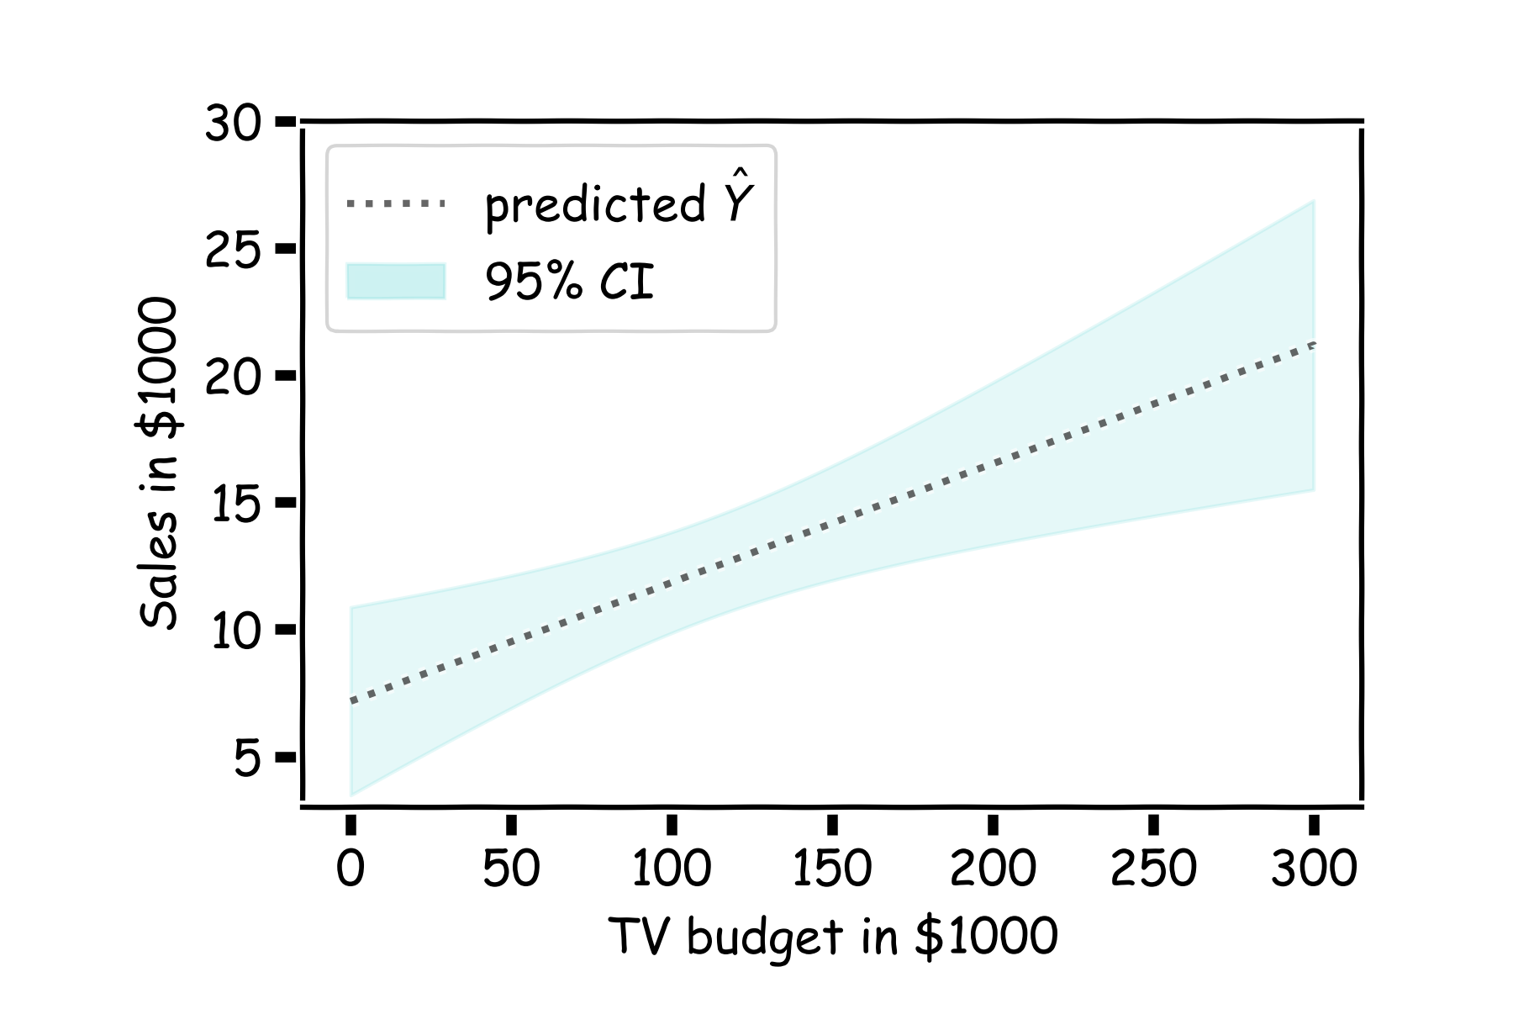
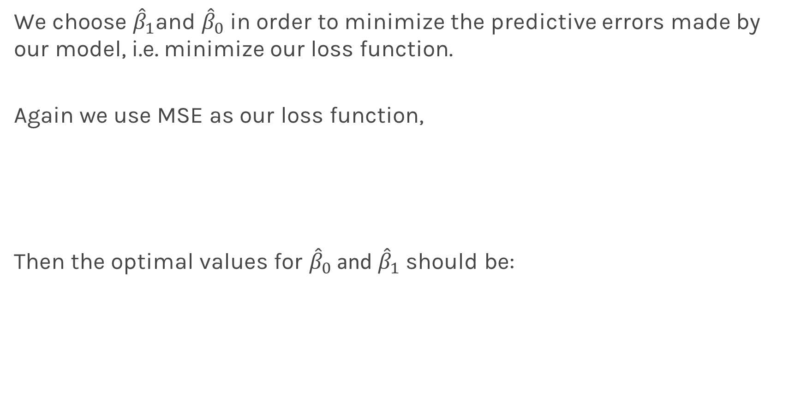
How well do we know $\hat{f}$?
For every $x$, we calculate the mean of the models, $\hat{f}$ (shown with dotted line) and the 95% CI of those models (shaded area).
Estimated $\hat{f}$

Slide 36
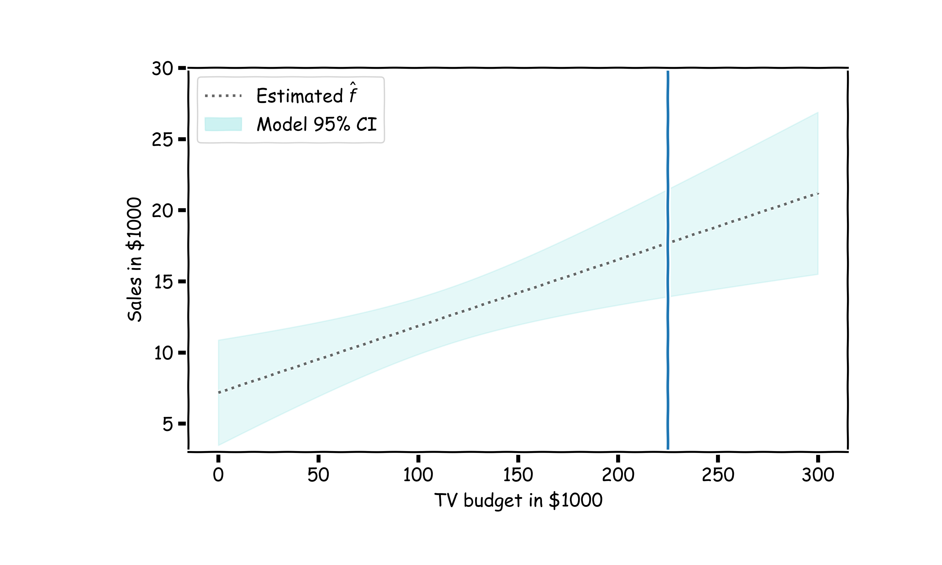
Confidence in predicting $\hat{y}$

Slide 37

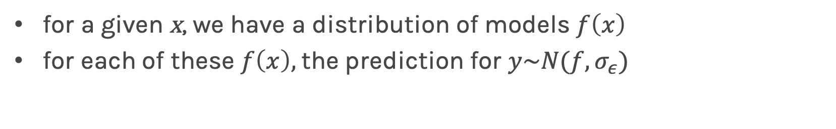
Confidence in predicting $\hat{y}$
for a given x, we have a distribution of models $f\left(x\right)$
for each of these $f\left(x\right),$the prediction for $y\sim N(f, σ_{ε})$

Slide 38
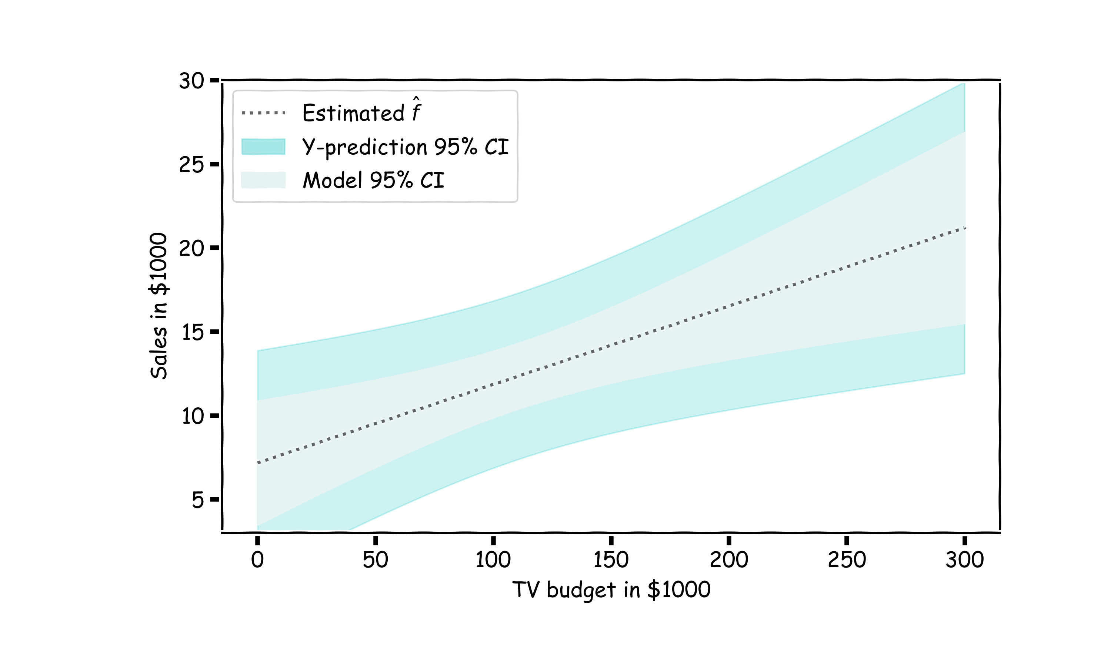
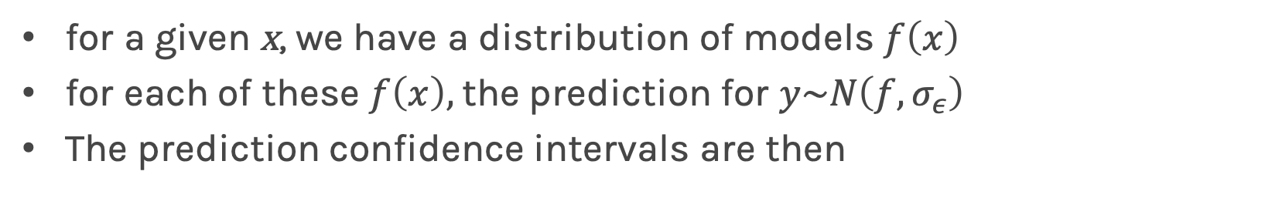
Confidence in predicting $\hat{y}$
for a given x, we have a distribution of models $f\left(x\right)$
for each of these $f\left(x\right),$the prediction for $y\sim N\left(f, σ_{ε}\right)$
The prediction confidence intervals are then

Slide 39
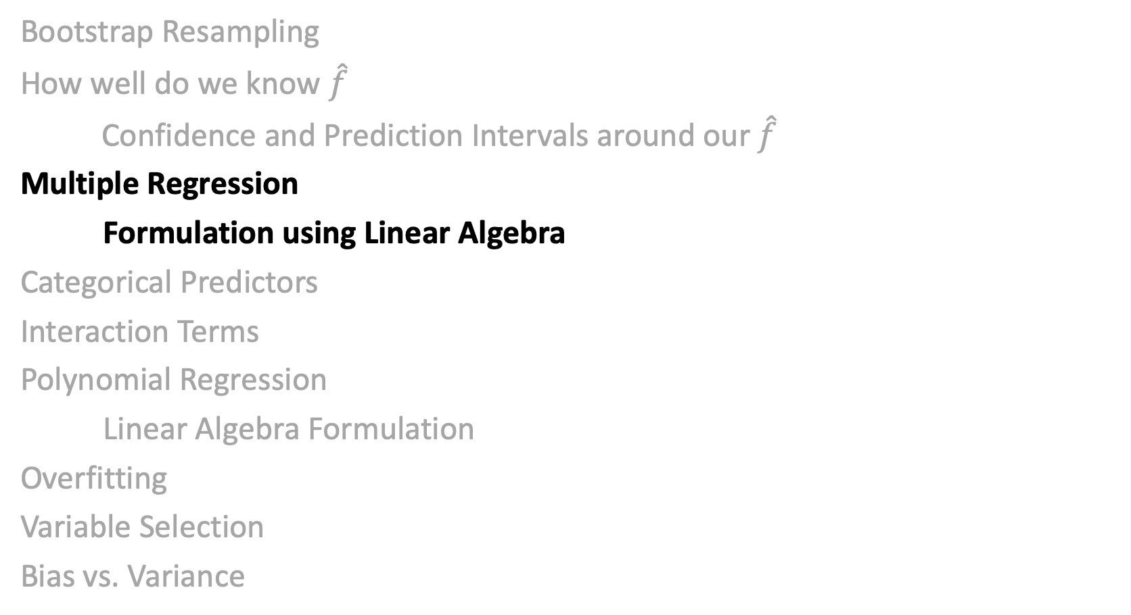
Lecture Outline
Bootstrap Resampling
How well do we know $\hat{f}$
Confidence and Prediction Intervals around our $\hat{f}$
Multiple Regression
Formulation using Linear Algebra
Categorical Predictors
Interaction Terms
Polynomial Regression
Linear Algebra Formulation
Overfitting
Variable Selection
Bias vs. Variance

Slide 40
Multiple Linear Regression
If you have to guess someone's height, would you rather be told
Their weight, only
Their weight and gender
Their weight, gender, and income
Their weight, gender, income, and favorite number
Of course, you'd always want as much data about a person as possible. Even though height and favorite number may not be strongly related, at worst you could just ignore the information on favorite number. We want our models to be able to take in lots of data as they make their predictions.

Slide 41
Response vs. Predictor Variables
X
predictors
features
covariates
Y
outcome
response variable
dependent variable
TV | radio | newspaper | sales
230.1 | 37.8 | 69.2 | 22.1
44.5 | 39.3 | 45.1 | 10.4
17.2 | 45.9 | 69.3 | 9.3
151.5 | 41.3 | 58.5 | 18.5
180.8 | 10.8 | 58.4 | 12.9
n observations
p predictors

Slide 42
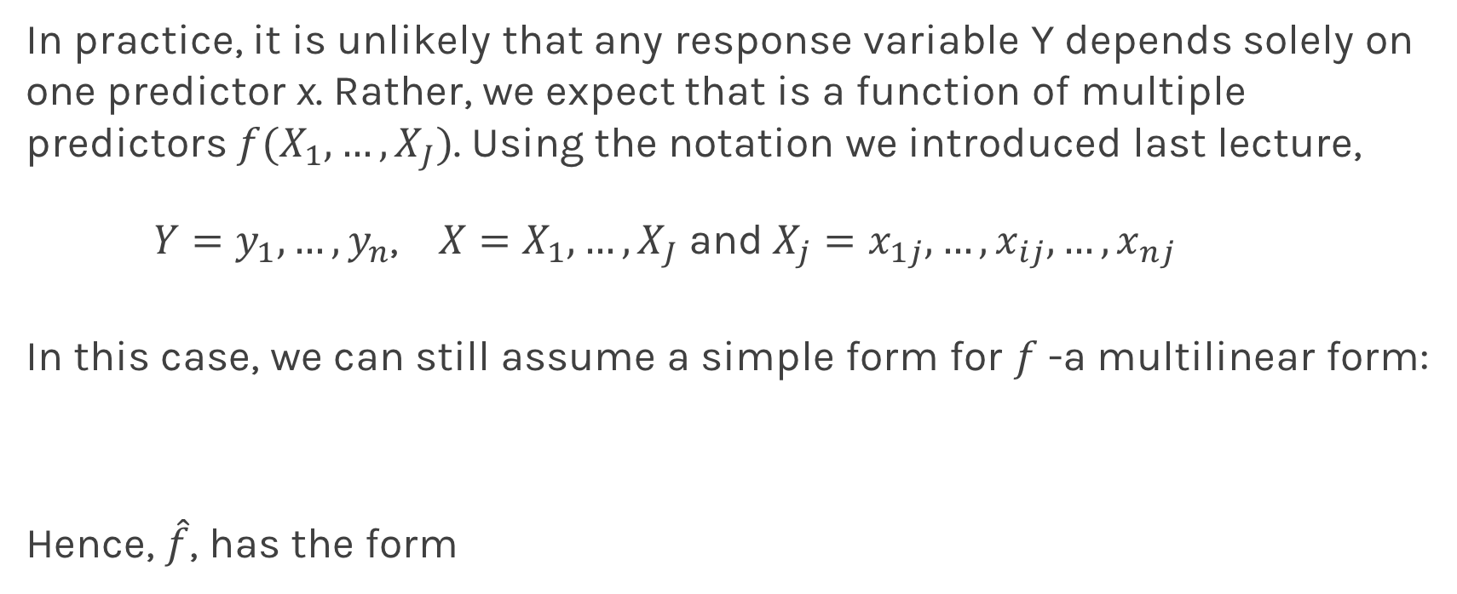
Multilinear Models
In practice, it is unlikely that any response variable Y depends solely on one predictor x. Rather, we expect that is a function of multiple predictors $f(X_{1},…,X_{J})$. Using the notation we introduced last lecture,
$Y=y_{1},…,y_{n}$, $X=X_{1},…,X_{J}$and$X_{j}=x_{1j},…,x_{ij},…,x_{nj}$
In this case, we can still assume a simple form for $f$-a multilinear form:
Hence, $\hat{f}$, has the form

Slide 43
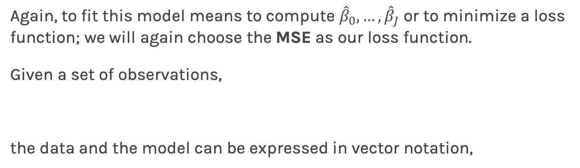
Multiple Linear Regression
Again, to fit this model means to compute ${\hat{β}}_{0},…,{\hat{β}}_{J}$ or to minimize a loss function; we will again choose the MSE as our loss function.
Given a set of observations,
the data and the model can be expressed in vector notation,
Notes:
We need a figure here

Slide 44
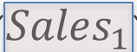
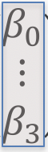
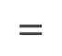

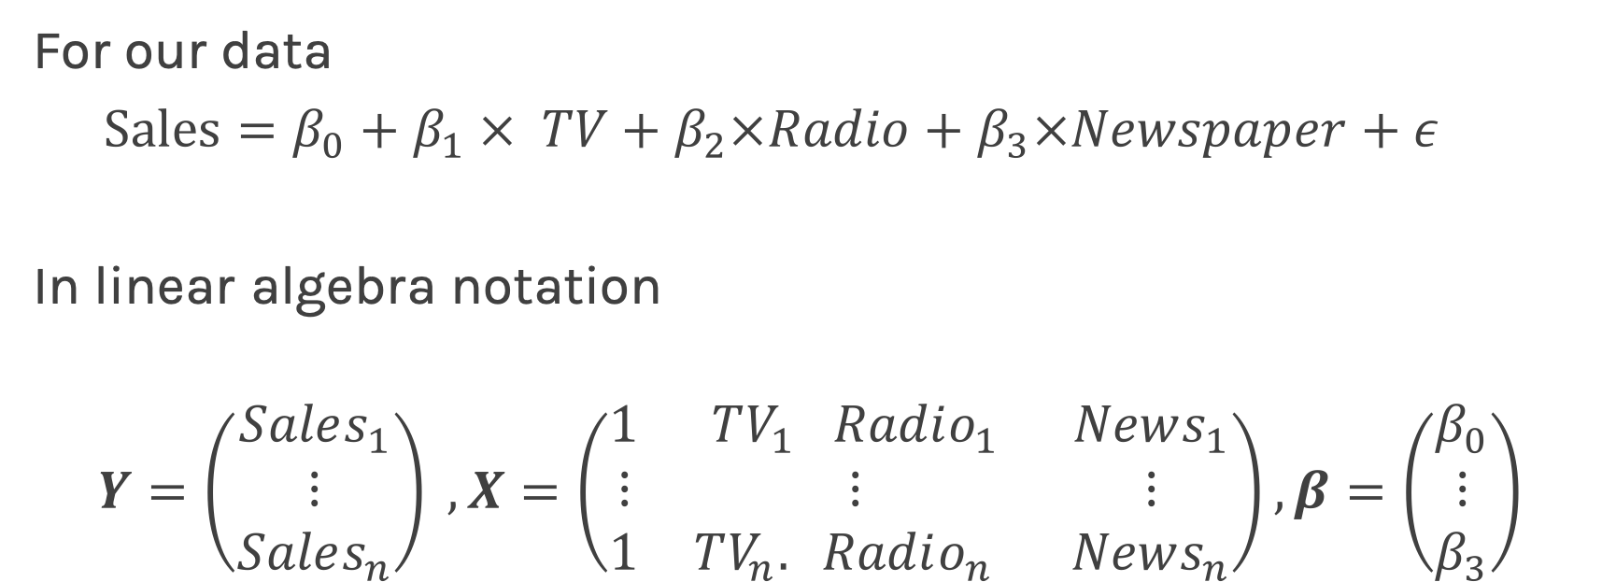
Multilinear Model, example
For our data
$Sales=β_{0}+β_{1} × TV+β_{2}×Radio+β_{3}×Newspaper+ε$
In linear algebra notation
$$Y=\left(\begin{matrix}Sales_{1} \\ ⋮ \\ Sales_{n}\end{matrix}\right) , X=\left(\begin{matrix}1 & TV_{1} Radio_{1} & News_{1} \\ ⋮ & ⋮ & ⋮ \\ 1 & TV_{n}. Radio_{n} & News_{n}\end{matrix}\right), β=\left(\begin{matrix}β_{0} \\ ⋮ \\ β_{3}\end{matrix}\right)$$
$$=$$
$$×$$

Slide 45
Multiple Linear Regression
The model takes a simple algebraic form:
Thus, the MSE can be expressed in vector notation as
Minimizing the MSE using vector calculus yields,
Notes:
We need a figure here

Slide 46
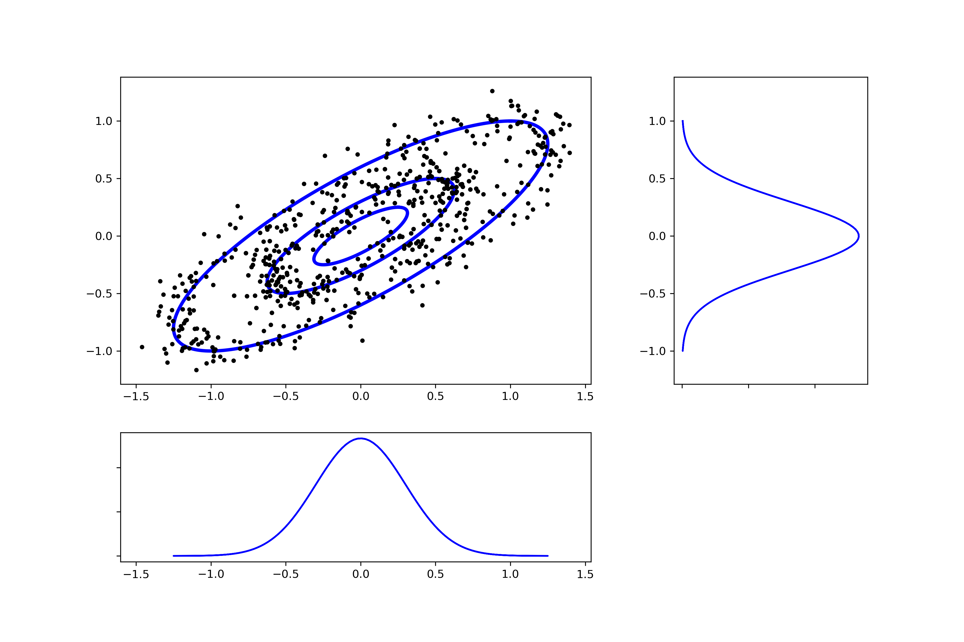
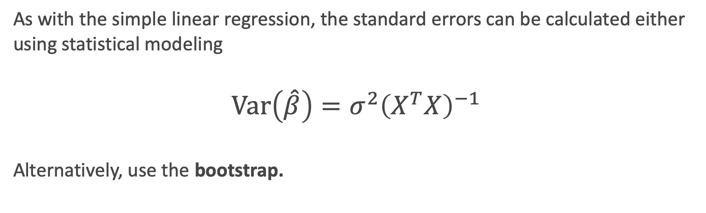
Standard Errors for Multiple Linear Regression
As with the simple linear regression, the standard errors can be calculated either using statistical modeling
$$Var\left(\hat{β}\right)=σ^{2}{\left(X^{T}X\right)}^{−1}$$
Alternatively, use the bootstrap.
Notes:
We need a figure here

Slide 47
Collinearity
Collinearity refers to the case in which two or more predictors are correlated (related).
We will re-visit collinearity in the next lecture when we address overfitting, but for now we want to examine how does collinearity affects our confidence on the coefficients and consequently on the importance of those coefficients.
Notes:
We need a figure here

Slide 48
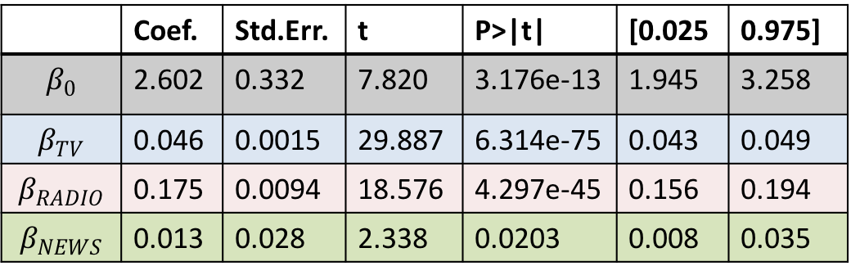
Collinearity
Three individual models
One model
TV
Coef. | Std.Err. | t | P>|t| | [0.025 | 0.975]
6.679 | 0.478 | 13.957 | 2.804e-31 | 5.735 | 7.622
0.048 | 0.0027 | 17.303 | 1.802e-41 | 0.042 | 0.053
RADIO
 | Coef. | Std.Err. | t | P>|t| | [0.025 | 0.975]
$$β_{0}$$ | 2.602 | 0.332 | 7.820 | 3.176e-13 | 1.945 | 3.258
$$β_{TV}$$ | 0.046 | 0.0015 | 29.887 | 6.314e-75 | 0.043 | 0.049
$$β_{RADIO}$$ | 0.175 | 0.0094 | 18.576 | 4.297e-45 | 0.156 | 0.194
$$β_{NEWS}$$ | 0.013 | 0.028 | 2.338 | 0.0203 | 0.008 | 0.035
Coef. | Std.Err. | t | P>|t| | [0.025 | 0.975]
9.567 | 0.553 | 17.279 | 2.133e-41 | 8.475 | 10.659
0.195 | 0.020 | 9.429 | 1.134e-17 | 0.154 | 0.236
NEWS
Coef. | Std.Err. | t | P>|t| | [0.025 | 0.975]
11.55 | 0.576 | 20.036 | 1.628e-49 | 10.414 | 12.688
0.074 | 0.014 | 5.134 | 6.734e-07 | 0.0456 | 0.102

Slide 49
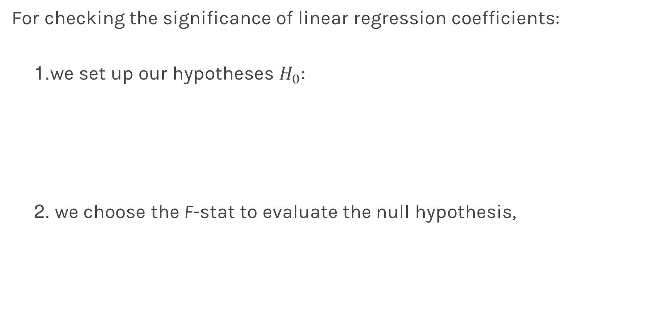
Finding Significant Predictors: Hypothesis Testing
For checking the significance of linear regression coefficients:
we set up our hypotheses $H_{0}$:
we choose the F-stat to evaluate the null hypothesis,

Slide 50
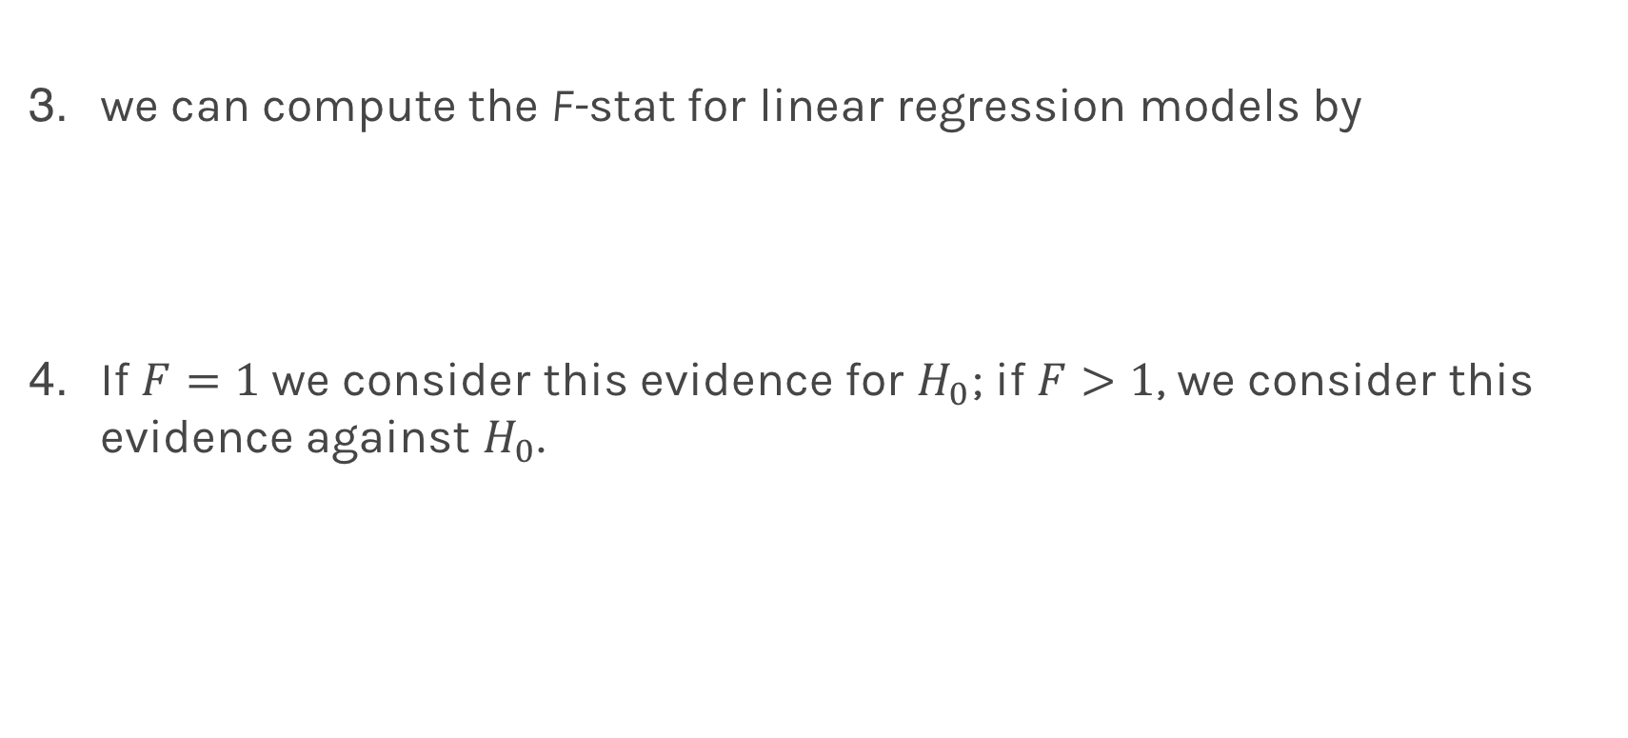
Finding Significant Predictors: Hypothesis Testing
we can compute the F-stat for linear regression models by
If $F=1$ we consider this evidence for $H_{0}$; if $F>1$, we consider this evidence against $H_{0}$.
2
2

Slide 51

Lecture Outline
Bootstrap Resampling
How well do we know $\hat{f}$
Confidence and Prediction Intervals around our $\hat{f}$
Multiple Regression
Formulation using Linear Algebra
Categorical Predictors
Interaction Terms
Polynomial Regression
Linear Algebra Formulation
Overfitting
Variable Selection
Bias vs. Variance

Slide 52
Qualitative Predictors
So far, we have assumed that all variables are quantitative. But in practice, often some predictors are qualitative.
Example: The Credit data set contains information about balance, age, cards, education, income, limit , and rating for a number of potential customers.
Income | Limit | Rating | Cards | Age | Education | Gender | Student | Married | Ethnicity | Balance
14.890 | 3606 | 283 | 2 | 34 | 11 | Male | No | Yes | Caucasian | 333
106.02 | 6645 | 483 | 3 | 82 | 15 | Female | Yes | Yes | Asian | 903
104.59 | 7075 | 514 | 4 | 71 | 11 | Male | No | No | Asian | 580
148.92 | 9504 | 681 | 3 | 36 | 11 | Female | No | No | Asian | 964
55.882 | 4897 | 357 | 2 | 68 | 16 | Male | No | Yes | Caucasian | 331

Slide 53
Qualitative Predictors
If the predictor takes only two values, then we create an indicator or dummy variable that takes on two possible numerical values.
For example for the gender, we create a new variable:
We then use this variable as a predictor in the regression equation.

Slide 54

Qualitative Predictors
Question: What is interpretation of $β_{0}$ and $β_{1}$?

Slide 55

Qualitative Predictors
Question: What is interpretation of $β_{0}$ and $β_{1}$?
$β_{0}$ is the average credit card balance among males,
$β_{0}+β_{1}$ is the average credit card balance among females,
and $β_{1}$ the average difference in credit card balance between females and males.
Example: Calculate $β_{0}$ and $β_{1}$ for the Credit data.
You should find $β_{0}\sim \$509,β_{1}\sim \$19$

Slide 56
More than two levels: One hot encoding
Often, the qualitative predictor takes more than two values (e.g. ethnicity in the credit data).
In this situation, a single dummy variable cannot represent all possible values.
We create additional dummy variable as:

Slide 57

More than two levels: One hot encoding
We then use these variables as predictors, the regression equation becomes:
Question: What is the interpretation of $β_{0}$, $β_{1}$, $β_{2}$?
Notes:
[ADD interpretation and ONE HOT ENCODING]

Slide 58

Lecture Outline
Bootstrap Resampling
How well do we know $\hat{f}$
Confidence and Prediction Intervals around our $\hat{f}$
Multiple Regression
Formulation using Linear Algebra
Categorical Predictors
Interaction Terms
Polynomial Regression
Linear Algebra Formulation
Overfitting
Variable Selection
Bias vs. Variance

Slide 59

Beyond linearity
In the Advertising data, we assumed that the effect on sales of increasing one advertising medium is independent of the amount spent on the other media.
If we assume linear model then the average effect on sales of a one-unit increase in TV is always $β_{1}$, regardless of the amount spent on radio.
Synergy effect or interaction effect states that when an increase on the radio budget affects the effectiveness of the TV spending on sales.

Slide 60
Beyond linearity
We change
To

Slide 61



What does it mean?
$$x_{Student}=\left\{\begin{aligned}\begin{matrix}0 & Balance=β_{0}+β_{1}×Income\end{matrix}. \\ \begin{matrix}1 & Balance=\left(β_{0}+β_{2}\right)+\left(β_{1}\right)×Income. \end{matrix}\end{aligned}\right.$$
$$x_{Student}=\left\{\begin{aligned}\begin{matrix}0 & Balance=β_{0}+β_{1}×Income\end{matrix}. \\ \begin{matrix}1 & Balance=\left(β_{0}+β_{2}\right)+\left(β_{1}+β_{3}\right)×Income\end{matrix}\end{aligned}\right.$$

Slide 62
Predictors predictors predictors
We have a lot predictors!
Is it a problem?
Yes: Computational Cost
Yes: Overfitting
Wait there is more …

Slide 63

Residuals
We started with
We assumed the exact form of $f\left(x\right),$to be,
$$f\left(x\right)=β_{0}+β_{1}x,$$
then estimated the ${\hat{β}}^{′}s.$
What if that is not correct? Instead:
$$f\left(x\right)=β_{0}+β_{1}x+φ\left(x\right),$$
But we model it as
$$\hat{y}=\hat{f}\left(x\right)={\hat{β}}_{0}+{\hat{β}}_{1}x$$
Then the residual
$$r=(y−\hat{y)}=\hat{f}\left(x\right)=ε+φ(x)$$

Slide 64

Residuals
Residual Analysis
When we estimated the variance of ϵ, we assumed that the residuals $r_{i}=y_{i}−{\hat{y}}_{i}$ were uncorrelated and normally distributed with mean 0 and fixed variance.
These assumptions need to be verified using the data. In residual analysis, we typically create two types of plots:
a plot of${ r}_{i}$with respect to $x_{i}$ or ${\hat{y}}_{i}$. This allows us to compare the distribution of the noise at different values of $x_{i}$.
a histogram of ${ r}_{i}$. This allows us to explore the distribution of the noise independent of $x_{i}$ or ${\hat{y}}_{i}$.

Slide 65


Residual Analysis

Slide 66

Lecture Outline
Bootstrap Resampling
How well do we know $\hat{f}$
Confidence and Prediction Intervals around our $\hat{f}$
Multiple Regression
Formulation using Linear Algebra
Categorical Predictors
Interaction Terms
Polynomial Regression
Linear Algebra Formulation
Overfitting
Variable Selection
Bias vs. Variance

Slide 67

Polynomial Regression
The simplest non-linear model we can consider, for a response Y and a predictor X, is a polynomial model of degree M,
Just as in the case of linear regression with cross terms, polynomial regression is a special case of linear regression - we treat each $x^{m}$ as a separate predictor. Thus, we can write

Slide 68
Polynomial Regression
Again, minimizing the MSE using vector calculus yields,

Slide 69

Polynomial Regression (cont)

Slide 70

Polynomial Regression (cont)

Slide 71

Polynomial Regression (cont)

Slide 72

Polynomial Regression (cont)

Slide 73

Polynomial Regression (cont)

Slide 74

Polynomial Regression (cont)

Slide 75
Polynomial Regression
The simplest non-linear model we can consider, for a response Y and a predictor X, is a polynomial model of degree M,
Just as in the case of linear regression with cross terms, polynomial regression is a special case of linear regression - we treat each $x^{m}$ as a separate predictor. Thus, we can write

Slide 76
Polynomial Regression is Multiple Regression!
Multiple Regression
n
Poly-Regression

Slide 77

Lecture Outline
Bootstrap Resampling
How well do we know $\hat{f}$
Confidence and Prediction Intervals around our $\hat{f}$
Multiple Regression
Formulation using Linear Algebra
Categorical Predictors
Interaction Terms
Polynomial Regression
Linear Algebra Formulation
Overfitting
Variable Selection
Bias vs. Variance

Slide 78

Overfitting

Slide 79




Overfitting with polynomials

Slide 80

Validation/Test

Slide 81

Overfitting
In statistical modeling, overfitting is the production of an analysis that corresponds too closely or exactly to a particular set of data, and may therefore fail to properly capture the true relationships or predict future (aka, out-of-sample) observations reliably.
You can think of overfitting as fitting to the particular intricacies of the residuals in the training set and not just the true signal in the relationship between the response and the predictors:
Think:
$$Y=f\left(X\right)+ε$$

Slide 82
Train-Validation-Test
Question:
What is a more honest representation of the performance of the model?
R2_test(degree=1) = 0.52
R2_train(degree=1) = 0.83

Slide 83

Lecture Outline
Bootstrap Resampling
How well do we know $\hat{f}$
Confidence and Prediction Intervals around our $\hat{f}$
Multiple Regression
Formulation using Linear Algebra
Categorical Predictors
Interaction Terms
Polynomial Regression
Linear Algebra Formulation
Overfitting
Variable Selection
Bias vs. Variance

Slide 84
Variable Selection
Variable selection (also called model selection) is the application of a principled method to determine the complexity of the model, e.g. choosing a subset of predictors, choosing the degree of the polynomial model etc.
A strong motivation for performing model selection is to avoid overfitting, which we saw can happen when:
there are too many predictors:
the feature space has high dimensionality
the polynomial degree is too high
too many interaction terms are considered
the coefficients values are too extreme (high multicollinearity)

Slide 85
Model Selection
Question:
How many different models could be used when considering a set of J predictors?

Slide 86


Model Selection
Example: 3 predictors $(X_{1},X_{2},X_{3})$
Models with 0 predictor:
M0: [intercept only]
Models with 1 predictor:
M1: $X_{1}$
M2: $X_{2}$
M3: $X_{3}$
Models with 2 predictors:
M4: {$X_{1},X_{2}\}$
M5: ${\{X}_{2},X_{3}\}$
M6: ${\{X}_{3},X_{1}\}$
Models with 3 predictors:
M7: {$X_{1},X_{2},X_{3}\}$
$2^{J}=8 Models$

Slide 87
Stepwise Variable Selection and Cross Validation
Selecting optimal subsets of predictors (including choosing the degree of polynomial models) through:
stepwise variable selection - iteratively building an optimal subset of predictors by optimizing a fixed model evaluation metric each time,
validation - selecting an optimal model by evaluating each model on validation/test set.
We will also address the issue of discouraging extreme values in model parameters later.

Slide 88

Stepwise Variable Selection: Forward method
In forward selection, we find an ‘optimal’ set of predictors by iterative building up our set.
1. Start with the empty set P0, construct the null modelM0.
2. For $k=1,…, J:$
2.1 Let $M_{k−1}$ be the model constructed from the best set of
$k−1$ predictors, $P_{k−1}$.
2.2 Select the predictor ${X_{n}}_{k}$, not in $P_{k−1}$, so that the model constructed from $P_{k}=$ ${X_{n}}_{k}∪P_{k−1}$ optimizes a fixed metric (this can be p-value, F-stat; validation/test MSE, $R^{2}$; or AIC/BIC on training set).
2.3 Let $M_{k}$ denote the model constructed from the optimal $P_{k}$.
3. Select the model $M$ amongst $\{M_{0}, M_{1},…, M_{J}\}$that optimizes a fixed metric (this can be validation MSE, $R^{2};$or AIC/BIS on training set)
*Note: this reverse direction (starting with the full model) is also possible: Backwards Stepwise

Slide 89
Stepwise Variable Selection Computational Complexity
How many models did we evaluate?
1st step, J Models
2nd step, J-1 Models (add 1 predictor out of J-1 possible)
3rd step, J-2 Models (add 1 predictor out of J-2 possible)
…

Slide 90

Lecture Outline
Bootstrap Resampling
How well do we know $\hat{f}$
Confidence and Prediction Intervals around our $\hat{f}$
Multiple Regression
Formulation using Linear Algebra
Categorical Predictors
Interaction Terms
Polynomial Regression
Linear Algebra Formulation
Overfitting
Variable Selection
Bias vs. Variance

Slide 92
Out-of-sample Prediction Error

Slide 93

Bias vs Variance

Slide 94

Bias vs Variance

Slide 95

Bias vs Variance

Slide 96

Linear models: 20 data points per line 2000 simulations

Slide 97

Bias vs Variance

Slide 98

Bias vs Variance

Slide 99

Bias vs Variance

Slide 100

Poly 10 degree models : 20 data points per line 2000 simulations

Slide 101
Bias vs Variance
Left: 2000 best fit straight lines, each fitted on a different 20 point training set.
Right: Best-fit models using degree 10 polynomial

Slide 102




Bias vs Variance
Left: Linear regression coefficients
Right: Poly regression of order 10 coefficients
$$β_{0}$$
$$β_{1}$$

